Slide 1
Practical CSS Use Cases
Lecturer: Ngo Huy Bien
Software Engineering Department
Faculty of Information Technology
VNUHCM - University of Science
Ho Chi Minh City, Vietnam
nhbien@fit.hcmus.edu.vn

Slide 2

Objectives

Slide 3

Contents

Slide 4

References

Slide 5
Web Accessibility
https://www.section508.gov/summary-section508-standards
https://www.w3.org/WAI/fundamentals/accessibility-intro/
https://www.w3.org/TR/WCAG20-TECHS/Overview.html
https://www.w3.org/WAI/ER/tools/

Slide 6
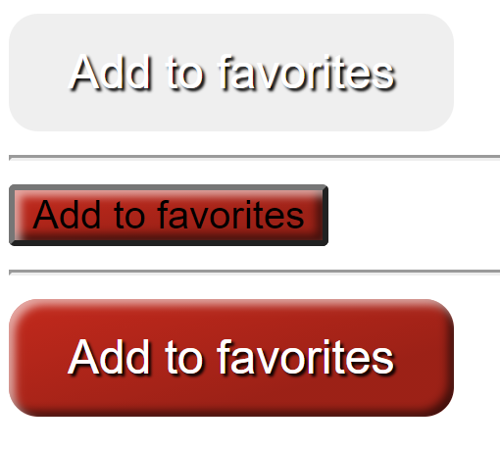
ID and Class Selector
<button id="fav_button">
Add to favorites
</button>
<hr />
<button class="styled1">
Add to favorites
</button>
<hr />
<button id="fav_button" class="styled1">
Add to favorites
</button>
#fav_button {
border: 0;
line-height: 2.5;
padding: 0 20px;
font-size: 1rem;
text-align: center;
color: #fff;
text-shadow: 1px 1px 1px #000;
border-radius: 10px;
}
.styled1 {
background-color: rgba(220, 0, 0, 1);
background-image: linear-gradient(to top left,
rgba(0, 0, 0, .2),
rgba(0, 0, 0, .2) 30%,
rgba(0, 0, 0, 0));
box-shadow: inset 2px 2px 3px rgba(255, 255, 255, .6),
inset -2px -2px 3px rgba(0, 0, 0, .6);
}

Slide 7
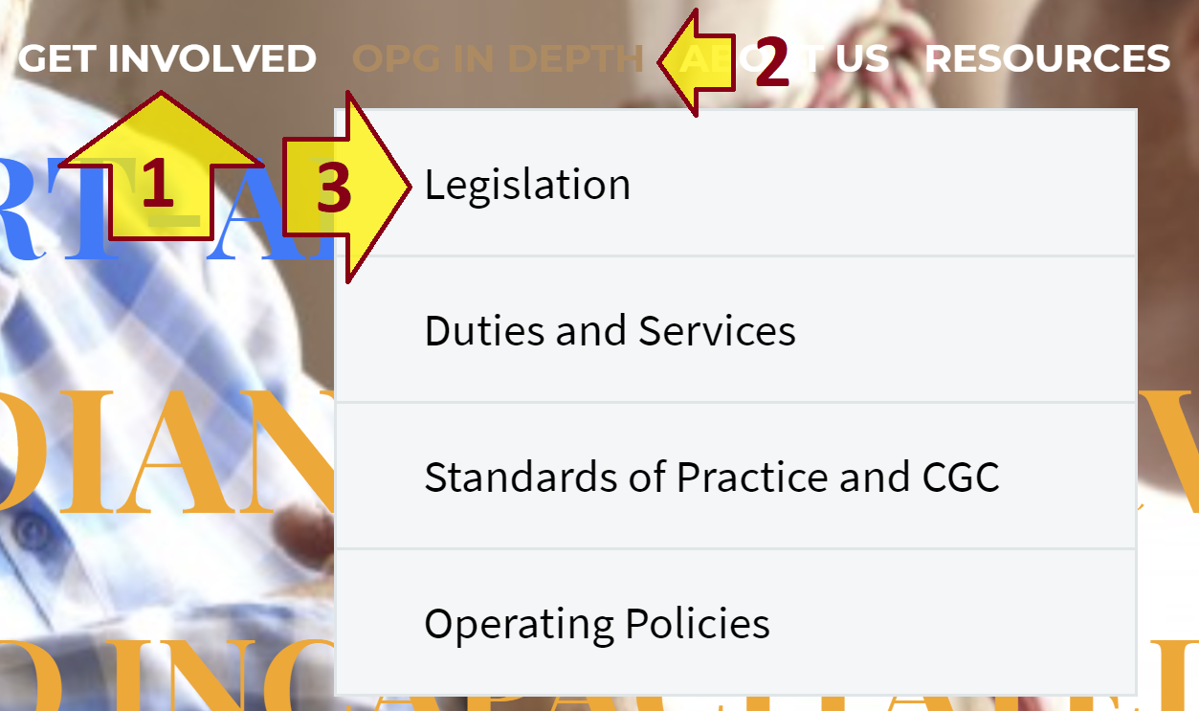
Child Combinator
A child combinator in CSS is the “greater than” symbol.
div.header-colors-light ul.nav-menu.styled.no-responsive.dl-menu > li > a,
div.header-colors-light ul.nav-menu.styled.no-responsive.dl-menu > li > a:active,
div.header-colors-light ul.nav-menu.styled.no-responsive.dl-menu > li > a:visited {
color: #ffffff !important;
}
ul.nav-menu.styled.no-responsive.dl-menu > li > a:hover {
color: #B68A5B !important;
}
ul.sub-menu.styled.dl-submenu-disabled > li > a,
ul.sub-menu.styled.dl-submenu-disabled > li > a:active,
ul.sub-menu.styled.dl-submenu-disabled > li > a:visited {
color: #000000 !important;
}
Select link items of list items that are descendants of an un-ordered list.

Slide 8
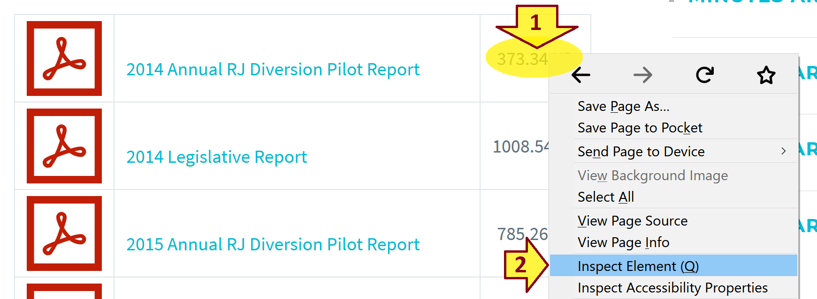
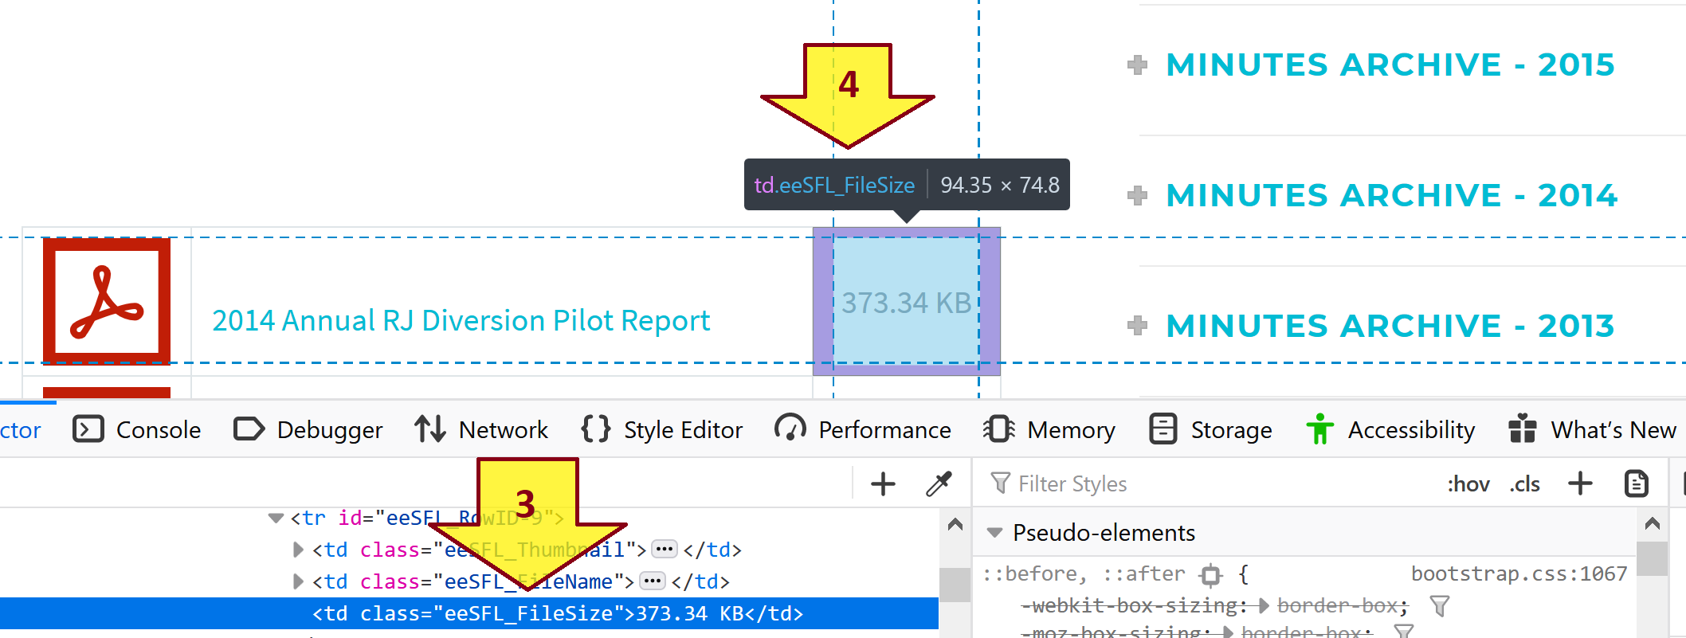
Inspect an Element CSS using Firefox

Slide 9
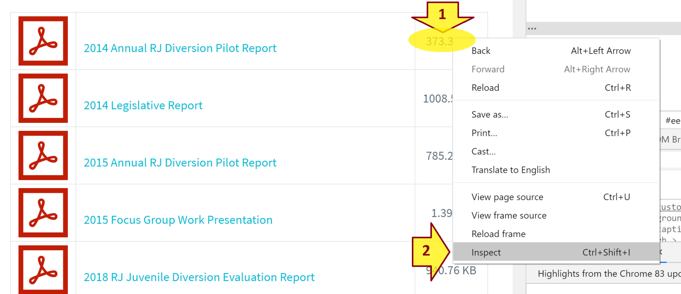
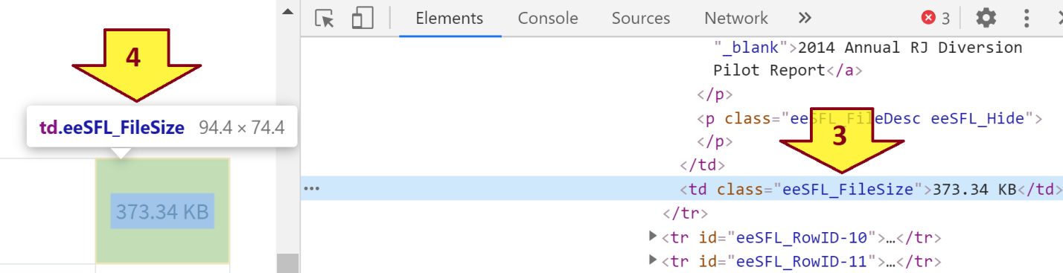
Inspect an Element CSS using Chrome

Slide 10
Modify the Element CSS based on the Inspection
td.eeSFL_FileName
{
border: solid 1px red;
display: none;
}

Slide 11
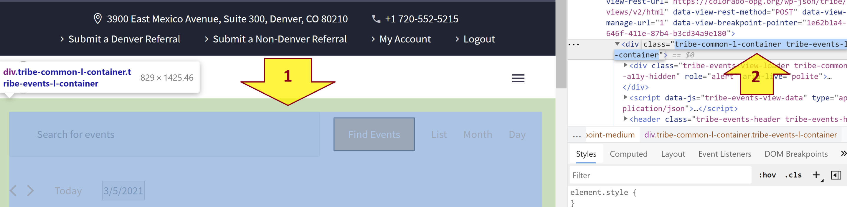
Inspect & Modify Complex Class (I)
.tribe-common-l-container.tribe-events-l-container
{
margin: 0px 0px 0px 0px;
background-color: #ffffff !important;
padding: 20px 20px 20px 20px !important;
}

Slide 12
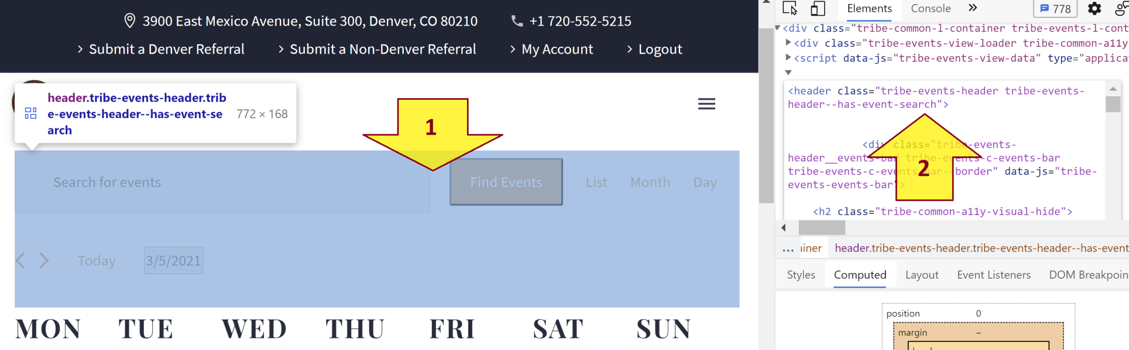
Inspect & Modify Complex Class (II)
header.tribe-events-header.tribe-events-header--has-event-search
{
margin: 0px 0px 0px 0px;
}

Slide 13
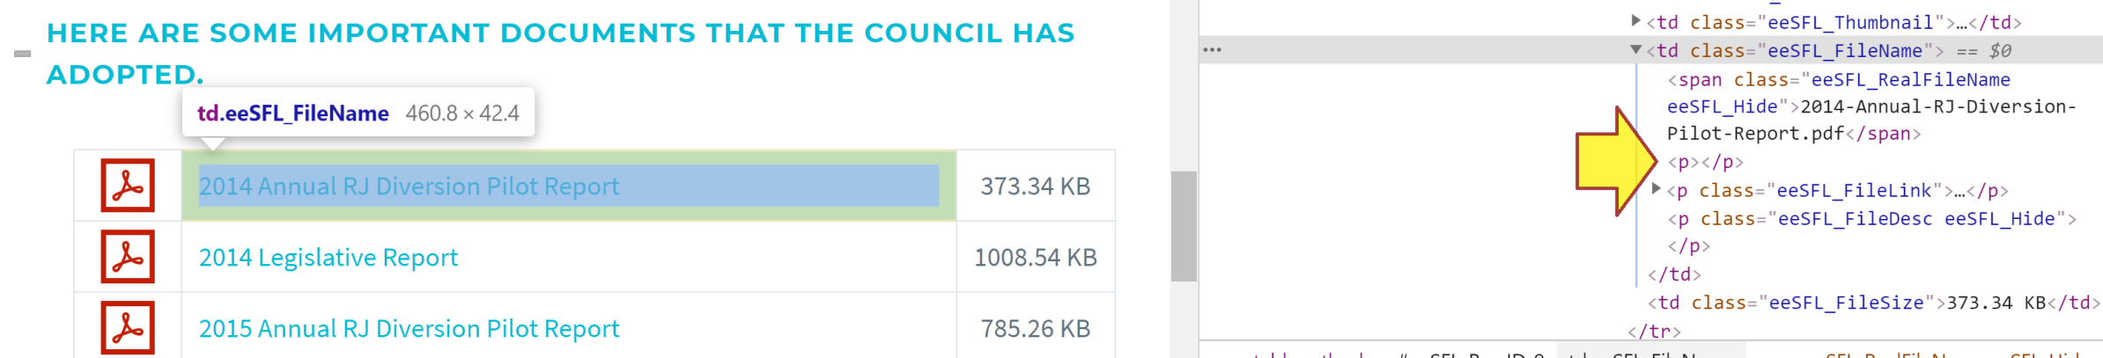
:first-of-type
td.eeSFL_FileName p:first-of-type
{
border: solid 1px red;
display: none;
}

Slide 14
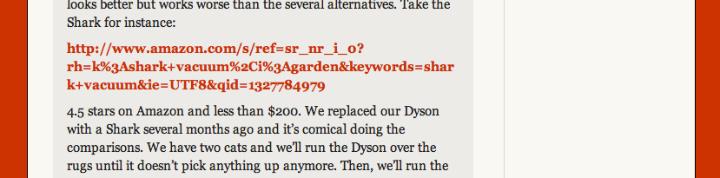
Handle Long Words and URLs
.dont-break-out {
/* These are technically the same, but use both */
overflow-wrap: break-word;
word-wrap: break-word;
-ms-word-break: break-all;
/* This is the dangerous one in WebKit, as it breaks things wherever */
word-break: break-all;
/* Instead use this non-standard one: */
word-break: break-word;
/* Adds a hyphen where the word breaks, if supported (No Blink) */
-ms-hyphens: auto;
-moz-hyphens: auto;
-webkit-hyphens: auto;
hyphens: auto;
}

Slide 15
Responsive iframe
<div class="container"> <iframe class="responsive-iframe" src="https://www.youtube.com/embed/u9Dg-g7t2l4"></iframe> </div>
.container { position: relative; overflow: hidden; width: 100%; padding-top: 56.25%; /* 16:9 Aspect Ratio (divide 9 by 16 = 0.5625) */ } /* Then style the iframe to fit in the container div with full height and width */ .responsive-iframe { position: absolute; top: 0; left: 0; bottom: 0; right: 0; width: 100%; height: 100%; }

Slide 16
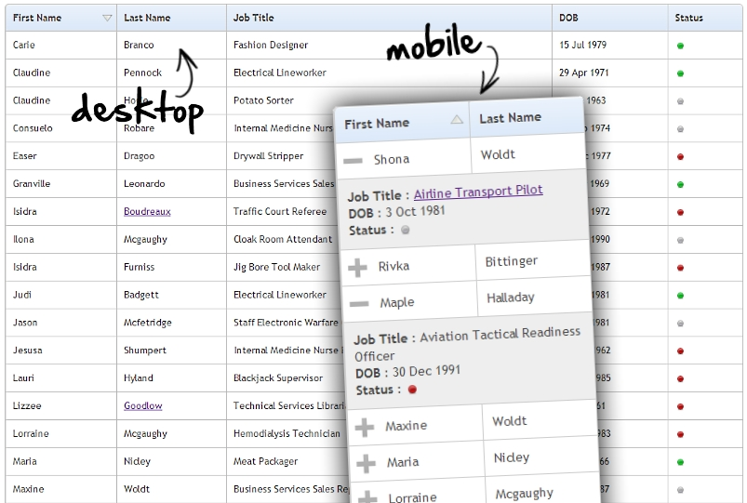
FooTable
https://css-tricks.com/footable-a-jquery-plugin-for-responsive-data-tables/

Slide 17

Thank You & See You Again

